Slide 1
Electron Density Map Data

Slide 2
Content
Background knowledge regarding Electron Density Map
Obtainment of Electron Density Map
Interpretation of Electron Density Map
Survey on Representation Learning for Electron Density Map.

Slide 3
Obtainment of Electron Density Map
88% of the entries in the Protein Data Bank were determined by X-ray crystallography (7% were determined by solution nuclear magnetic resonance and about 5% by cryo-Electro Microscope)
X-ray crystallographic produces an electron density map. The amino acid sequence is known in advance. The crystallographer fits the atoms of the known molecules into the electron density map to reconstruct the map.

Slide 4
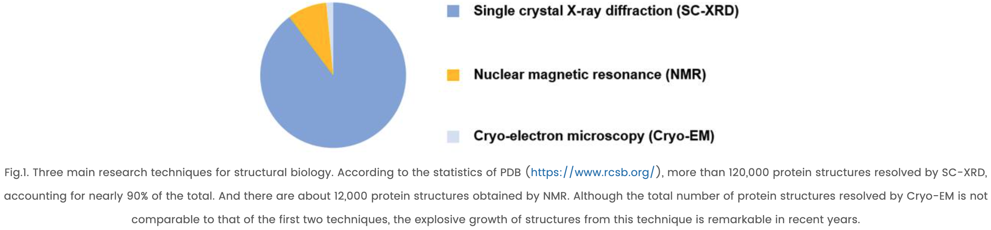
Comparison of Crystallography and Electron Microscopy
Comparison of Crystallography, NMR and EM

Slide 5
The Illustration of Isomesh
The standard deviation of all density values, sigma, is used to describe the strength of features in a map. (“3 sigma peak” is a feature that has a density value higher than three sigma over the average value, which is typically set to 0)

Slide 6
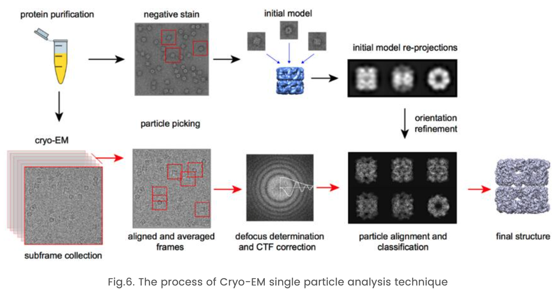
Cryo-electron microscopy (Cryo-EM)

Slide 7
Comparison of Crystallography and Electron Microscopy
Single crystal X-ray diffraction
Advantages: Yield high atomic resolution.
Disadvantages: The sample must be crystallisable, which is difficult for biological macromolecules with large molecular weight.
Nuclear magnetic resonance (NMR)
Disadvantages: The NMR spectrum of biomolecules with large molecular weights is complicated and hard to interpret.
Cryo-electron microscopy (Cryo-EM)
A Closer-to-native state is maintained, doesn’t need crystallisation
Higher-resolution compared to XRD.

Slide 8
Representation Learning for Electron Density Map
Tasks:
Structure prediction (protein backbone structure / ligand recognition)
Low-resolution refinement

Slide 9
Representation Learning for Electron Density Map
Derived tasks from the electron density map
Predicting protein’s backbone structure, secondary structure elements, and $C_{α}$ atoms from cascaded-CNN
Si, D., Moritz, S.A., Pfab, J., Hou, J., Cao, R., Wang, L., Wu, T., & Cheng, J. (2020). Deep Learning to Predict Protein Backbone Structure from High-Resolution Cryo-EM Density Maps. Scientific Reports, 10.

Slide 10
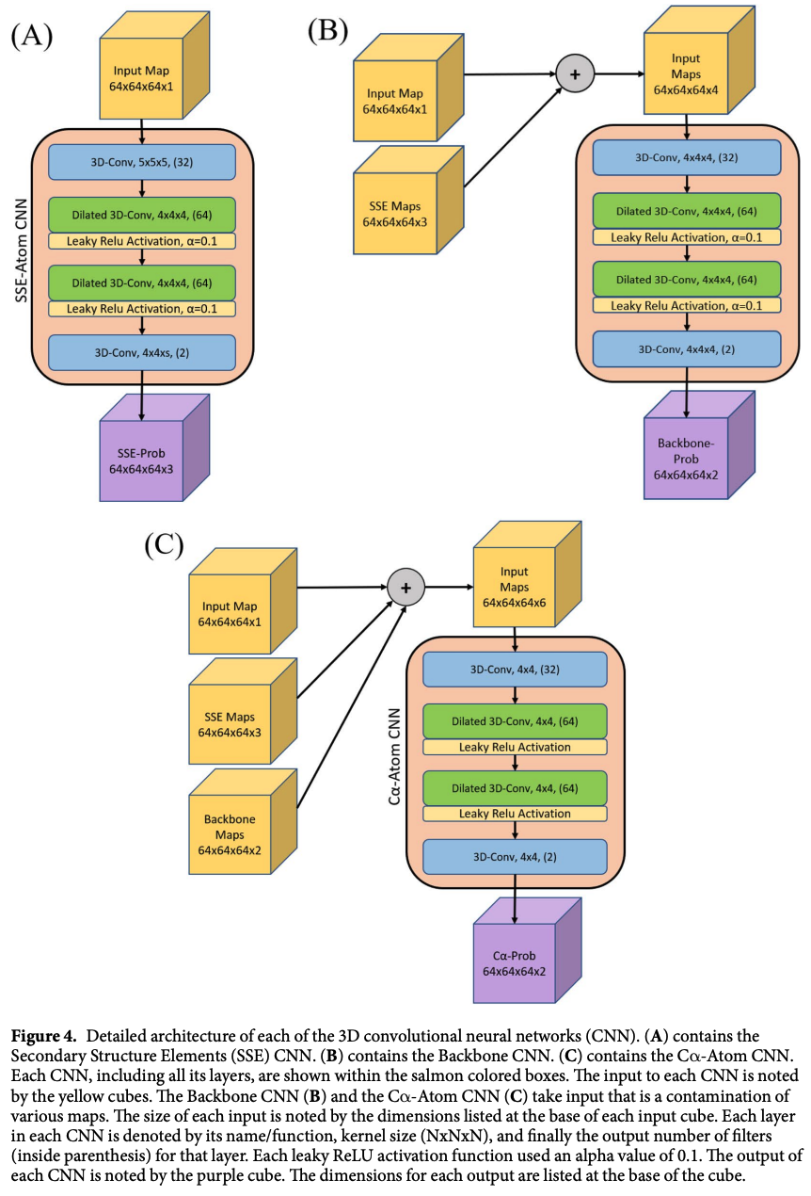
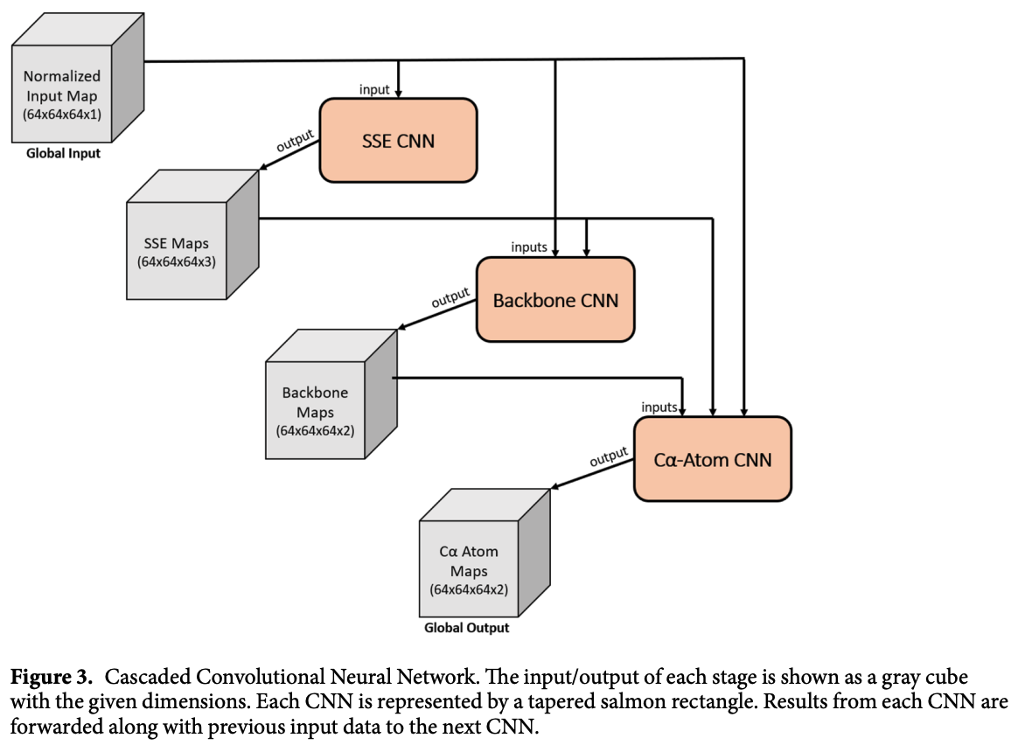

Slide 11
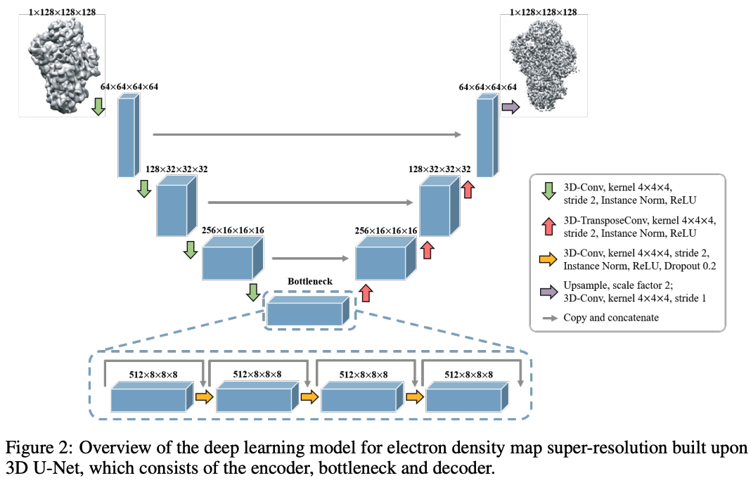
Mullick, B., Wang, Y., Yadev, P., & Farimani, A.B. (2020). Learning Super-Resolution Electron Density Map of Proteins using 3D U-Net.

Slide 12
Overview of works processing voxel data
D. Maturana and S. Scherer, "VoxNet: A 3D Convolutional Neural Network for real-time object recognition," 2015 IEEE/RSJ International Conference on Intelligent Robots and Systems (IROS), 2015, pp. 922-928, doi: 10.1109/IROS.2015.7353481.
Qi, C., Su, H., Mo, K., & Guibas, L.J. (2017). PointNet: Deep Learning on Point Sets for 3D Classification and Segmentation. 2017 IEEE Conference on Computer Vision and Pattern Recognition (CVPR), 77-85.
Qi, C., Yi, L., Su, H., & Guibas, L.J. (2017). PointNet++: Deep Hierarchical Feature Learning on Point Sets in a Metric Space. NIPS.
Wu, Z., Song, S., Khosla, A., Yu, F., Zhang, L., Tang, X., & Xiao, J. (2015). 3D ShapeNets: A deep representation for volumetric shapes. 2015 IEEE Conference on Computer Vision and Pattern Recognition (CVPR), 1912-1920.

